Slide 1
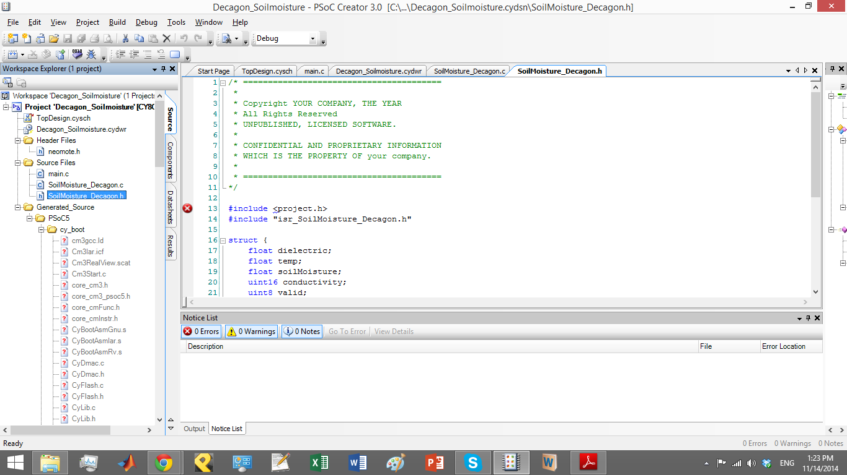
This one checks for where our
customized file are located
(Source files)

Slide 2
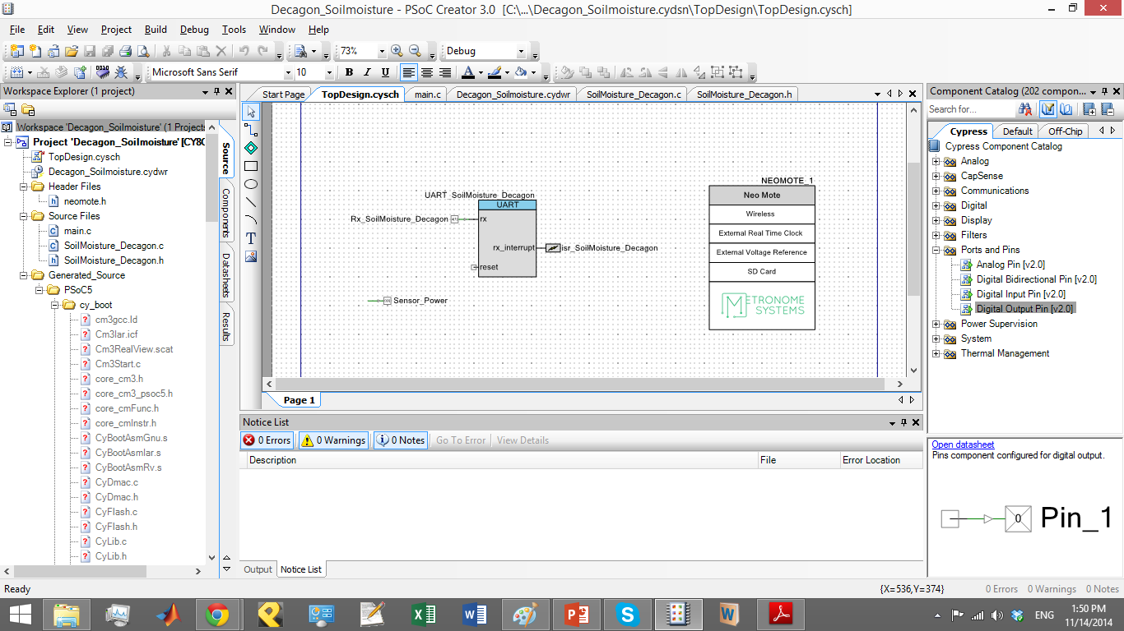
TopDesign of Soil Moisture Sensor

Slide 3
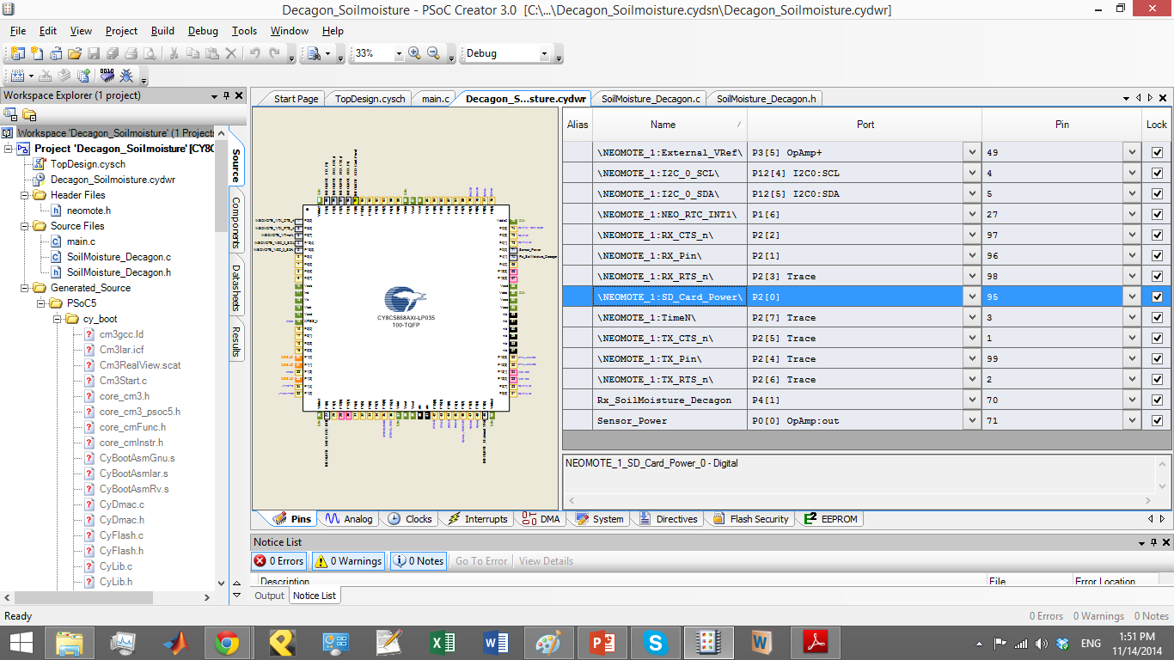
Pin Assignment for Soil Moisture Sensor

Slide 4
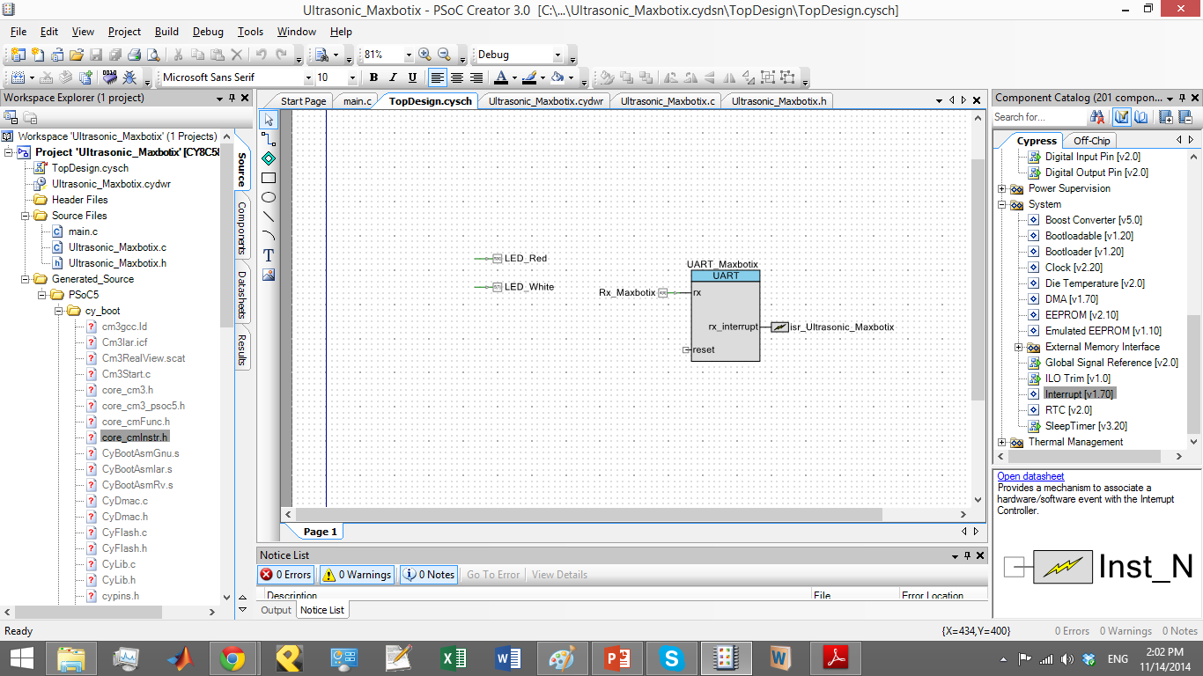
Top Design for Maxbotix Sensor

Slide 5
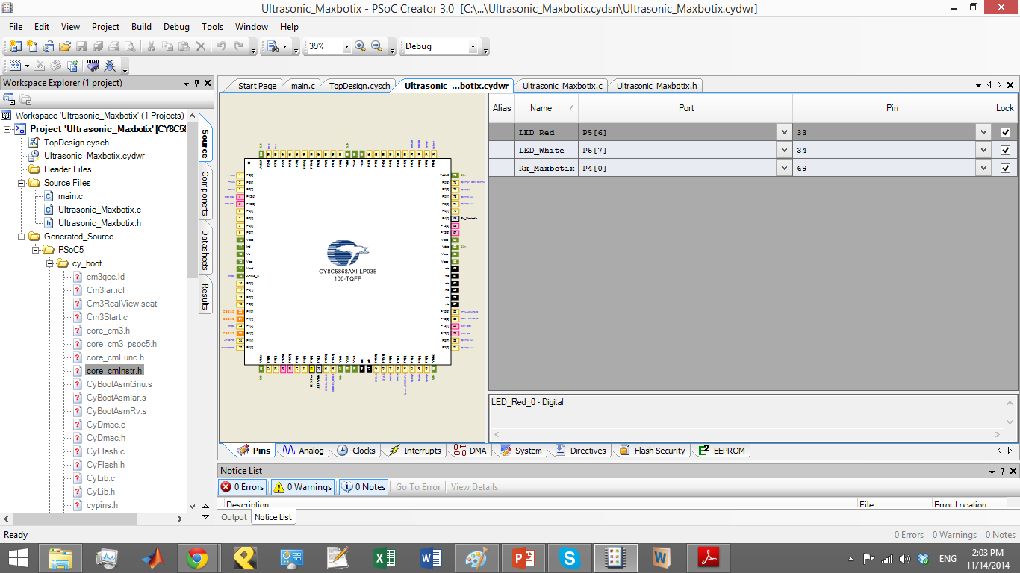
Maxbotix Pin assignment. First configuration.
The reading should be triggered by turning on the power pin.

